Slide 1
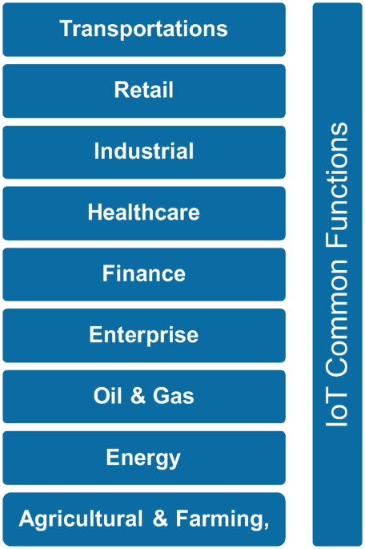
Module:7 Sensors for IoT
Sensor-Cloud; Fog Computing, Smart Cities and Smart Homes, Connected Vehicles, Smart Grid, Industrial IoT, Case Study: Agriculture, Healthcare, Activity Monitoring

Slide 2
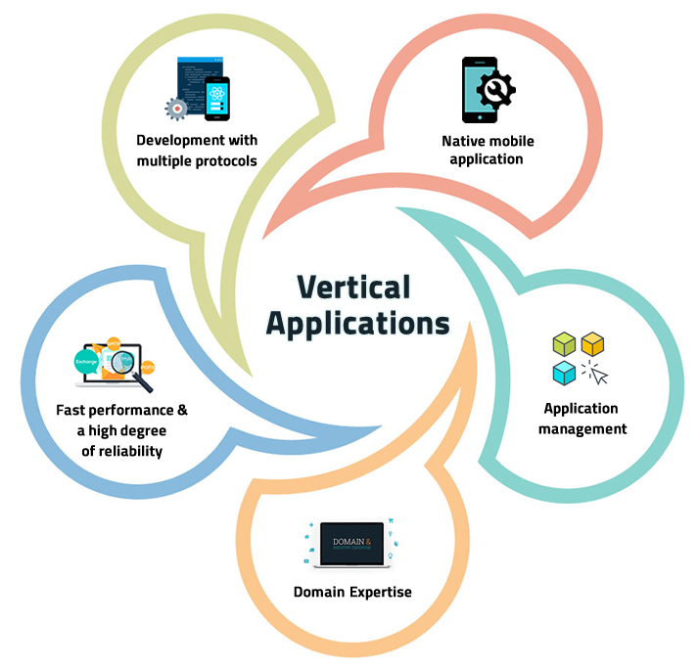
Contents
Roadmap for developing complete IoT solutions;
Smart Cities
Healthcare
Agriculture and Farming

Slide 3
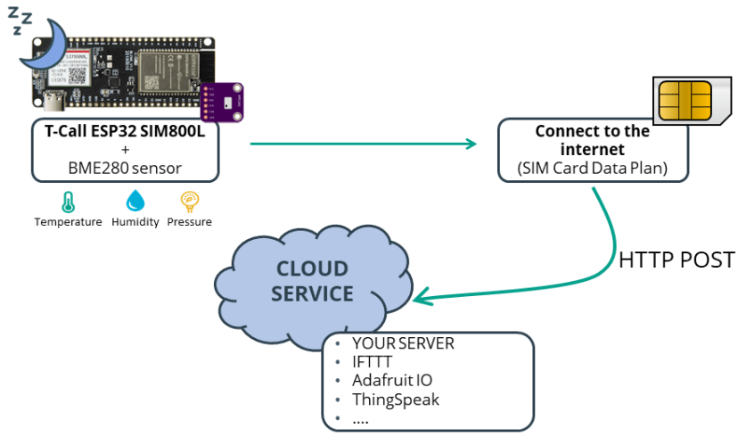

Slide 4
“CLOUD and FOG Computing”

Slide 5
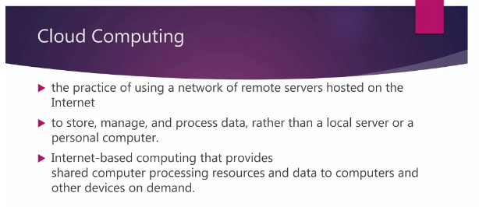
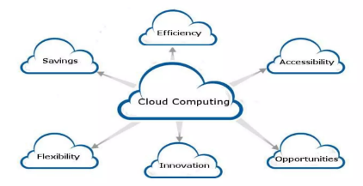
Benefits of Cloud Computing

Slide 6
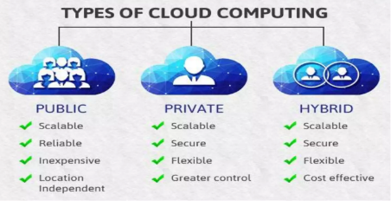
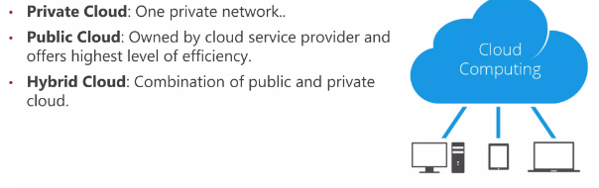

Slide 7
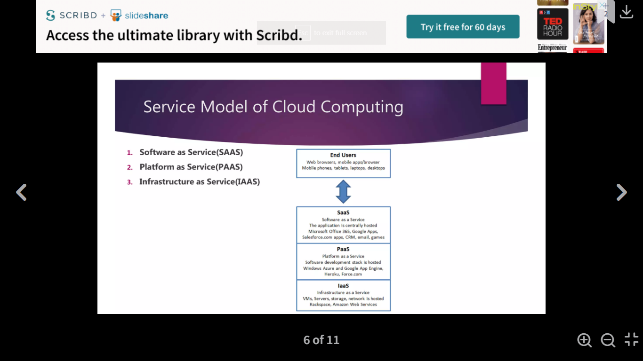
Software as a Service (SaaS): SaaS is also known as "on-demand software". It is a software in which the applications are hosted by a cloud service provider. Users can access these applications with the help of internet connection and web browser. Example: Microsoft 365, Google Apps, Salesforce, Dropbox, ZenDesk, Cisco WebEx,
Platform as a Service (PaaS): PaaS cloud computing platform is created for the programmer to develop, test, run, and manage the applications. Example: AWS Elastic Beanstalk, Windows Azure, Heroku, Force.com, Google App Engine, Apache Stratos, Magento Commerce Cloud, and OpenShift
Infrastructure as a Service (IaaS): IaaS is also known as Hardware as a Service (HaaS). It is a computing infrastructure managed over the internet. The main advantage of using IaaS is that it helps users to avoid the cost and complexity of purchasing and managing the physical servers. Eg - DigitalOcean, Linode, Amazon Web Services (AWS), Microsoft Azure, Google Compute Engine (GCE), Rackspace, and Cisco Metacloud

Slide 8
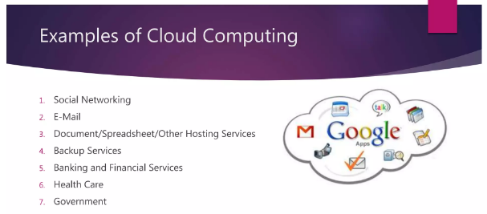
Disadvantages of Cloud Computing:
Organizational charges are needed for adapting the new technology
Vendor relationship management
Less control over business assets
Security, privacy and legal compliance is difficult
Physical location of s/w and h/w is unknown
Requires internet connection
Requires data backup on a secure server
Requires higher bandwidth which increases cost
Can relatively affect application performance

Slide 9
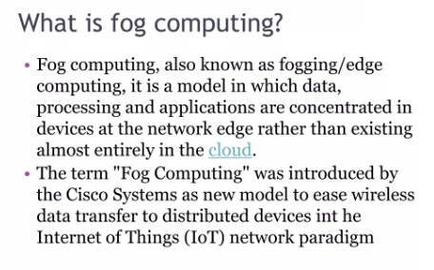

Slide 10
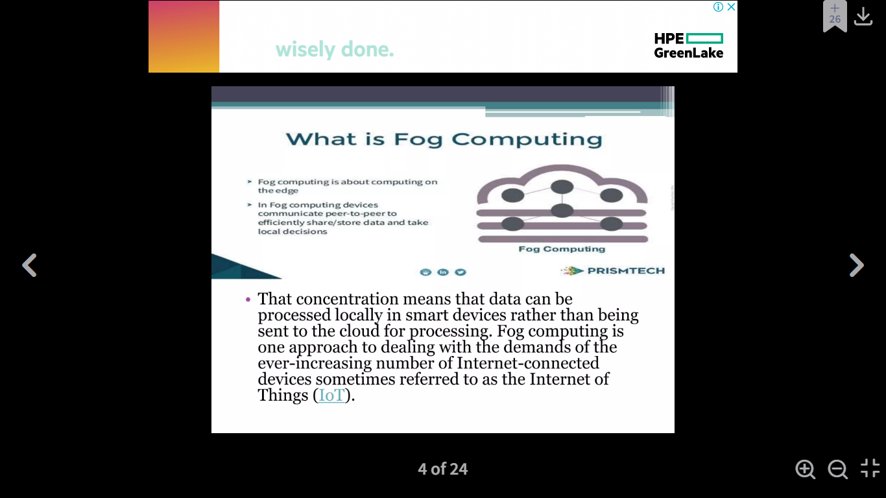

Slide 11
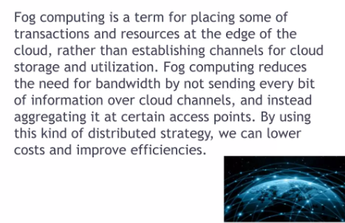

Slide 12
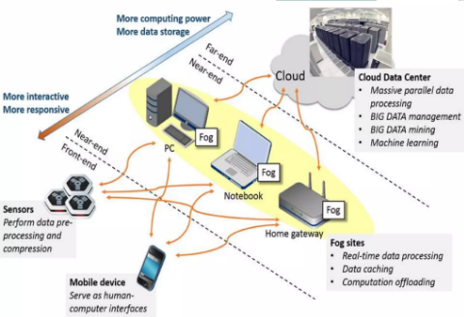

Slide 13
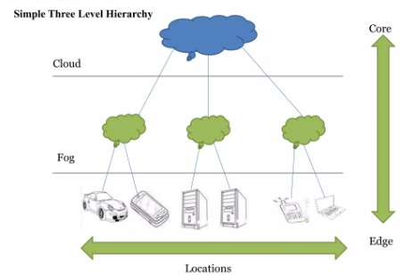
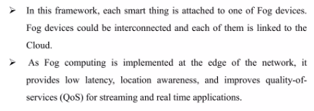

Slide 14
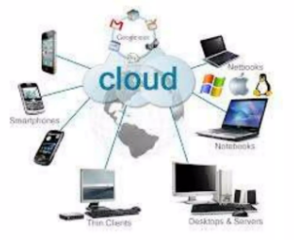
Cloud Computing Vs Fog Computing

Slide 15
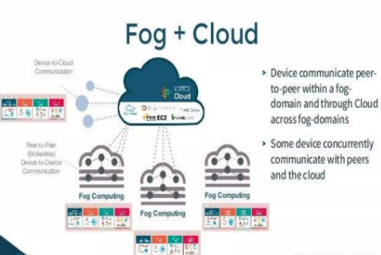

Slide 16
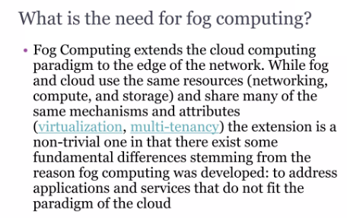

Slide 17
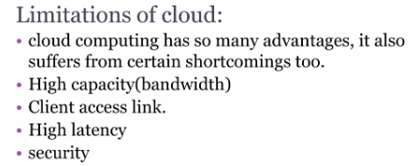
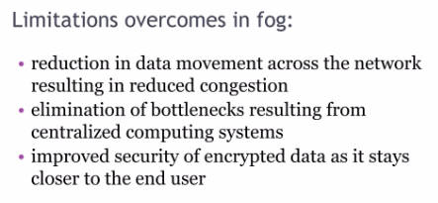

Slide 18
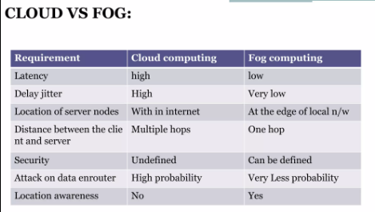
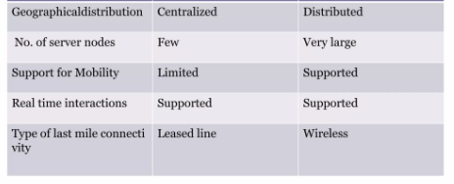

Slide 19
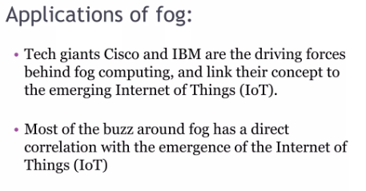
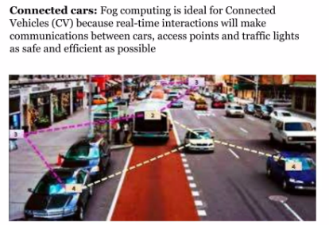

Slide 20
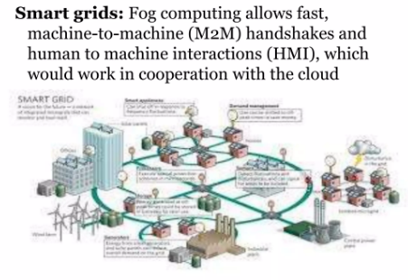
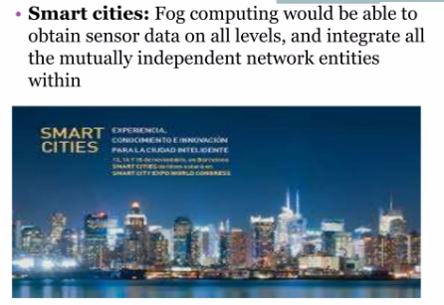

Slide 21
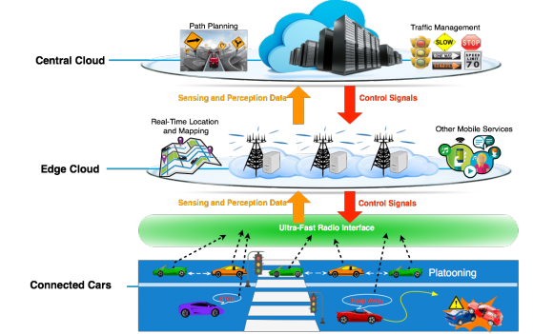
Connected CARS

Slide 22
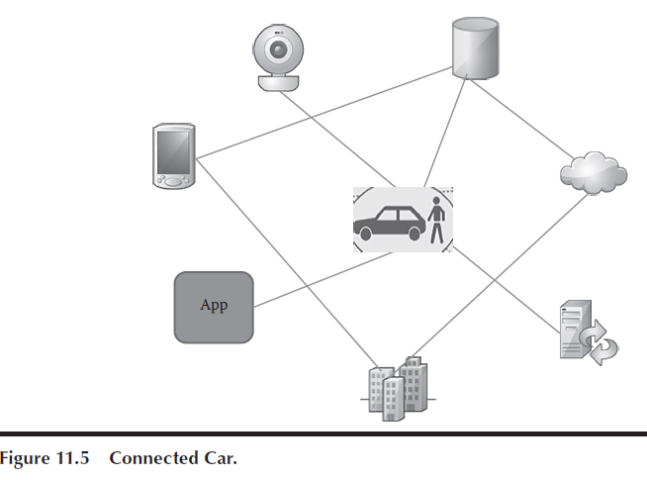
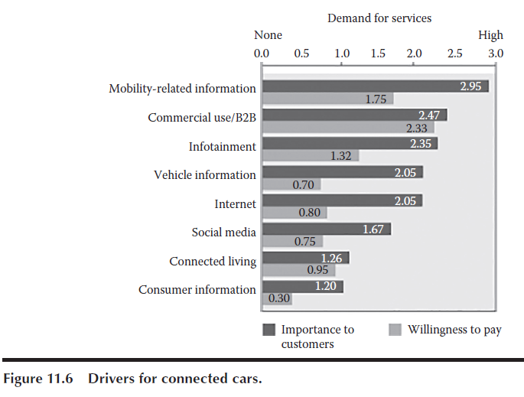
Connected Cars
Connected car is another prominent use case of IoT.
The connected car enables the exchange of information between the car and its surroundings via the Internet to devices which are a part of the IoT ecosystem.
The vehicle’s connection to the Internet is provided either by a transmitter/receiver
unit built into the vehicle itself or via third-party systems such as smartphones.

Slide 23
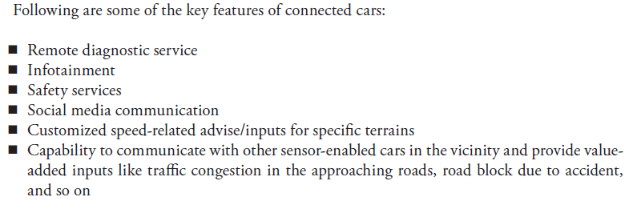

Slide 24
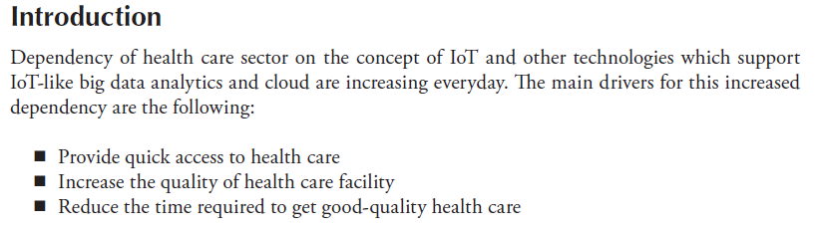
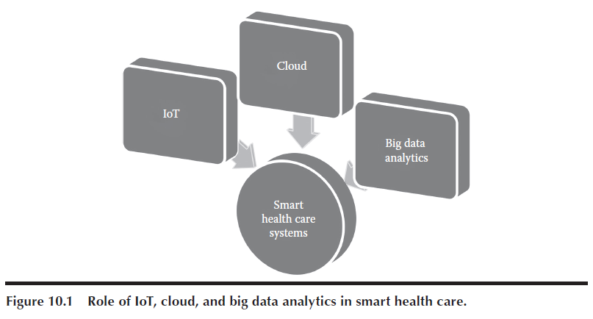
Smart Health Care Systems

Slide 25
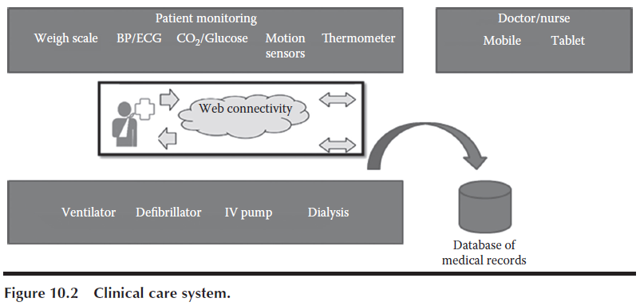
The two dimensions for the usage of IoT in health care are the following:
A. Clinical Care
IoT-driven non-invasive monitoring technology allows critically ill patients to be monitored at home using sensors which collect comprehensive physiological information of various vital body parameters of patients.
The data collected are sent using gateways and wireless networks to close relatives and caretakers for appropriate action.
This IoT technique replaces the traditional in-person continuous monitoring at hospitals by health care professionals and doctors.
This method provides improved automated health care at home at affordable cost.

Slide 26
B. Remote Monitoring
People who stay in remote areas typically do not have access to continuous health monitoring.
Wireless sensors interconnected using IoT make health monitoring available for these patients.
These wireless solutions collect body parameters using sensors, apply complex algorithms for data analysis, and then share the analyzed data with doctors or health care professionals who can provide relevant health recommendations to patients.
The different types of scenarios which demand monitoring are summarized in
Providing special care for pediatric and aged – This mainly facilitates administration of treatment at home. Pediatric patients require special care and attention. Aged people have many chronic diseases. Monitoring such patients require careful tracking of their several physiological parameters, movements, and activities.
Providing care for chronic disease management - Several chronic diseases like diabetes, high cholesterol, obesity, and cardiovascular diseases affect huge masses of population across the world. Management of these chronic diseases involves monitoring and managing the lifestyle of patients using continuous engagement methods.

Slide 27
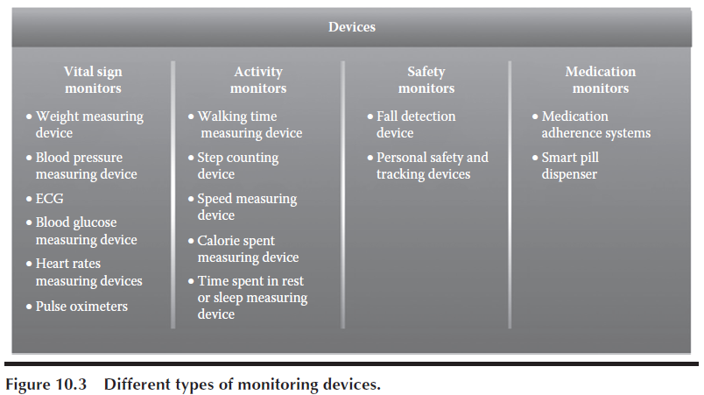
Other Interesting Use Cases of IoT
mHealth
Education and awareness
Remote data collection
Remote monitoring
Communication and training for health care workers
Disease and epidemic outbreak tracking
Diagnostics and treatment support
Virtual consultation (telemedicine)

Slide 28
Challenges in the IoT Health Care Sector
Managing diversity and interoperability of devices - When IoT is used in the health care domain, data are collected from a variety of devices and instruments and are sent to the databases using gateways defined through certain standards or regulations.
Data integration: it is required to integrate data from several sensors like weighing scales, blood pressure monitors, electrocardiography (ECG) monitors, glucose meters, fitness equipments, social networks, imaging systems, and several other web resources to give a meaningful interpretation.
Scale, data volume, and performance of data: As more and more devices are getting integrated into the IoT system, more will be the amount of data which will get ingested, stored, and analyzed in order to derive meaningful inferences.
Rapid evolution of applications:
Data privacy:
Need for medical expertise:

Slide 29
Future Trends for IoT in Health Care
1. Ingestible Sensor
Ingestible sensor is the sensor technology which is made available in the form of a pill.
The pill is made of ingredients which are present in normal food, and the sensor gets activated only on ingestion.
This sensor-based pill is consumed along with other prescribed medications by tracking the exact time of ingestion of the pill in order to track compliance to medication.
The sensor in the pill gets powered on by the body fluids through chemical reaction in the stomach and no battery or antenna is required.
This sensor which stays in the patient’s stomach provides real-time updates on how the patient responds to medicine.
No other types of diagnostic tests are required for these patients.
After activation, sensor also generates and transmits a unique number. Along with the unique number, the ingestible sensor also transmits various body parameters, activity, and rest patterns to the user’s mobile device.
These parameters from the mobile device are passed on to a central gateway from where it is sent to a secured data server.
All the authenticated agents get necessary information from this data server.

Slide 30
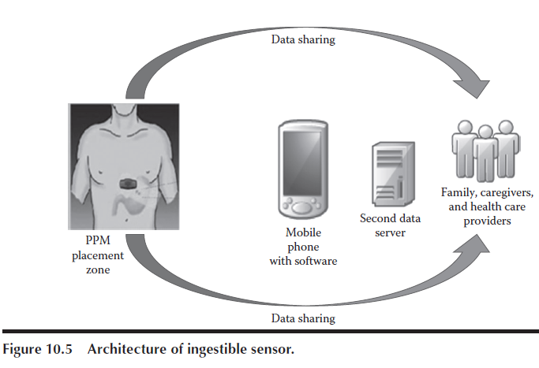

Slide 31
2. Digital Medicine
In case of digital medicine, the medicine itself goes digital.
Digital medicines will resemble the medicines of present day with only an additional component: a tiny sensor which can provide vital information about medication-consuming behaviours and responsiveness of body to the medicine along with several other body parameters which may need to be tracked.
These sensors are only activated when they come in contact with the acid present in the stomach.
Digital medicines will revolutionize the health care industry because of the capability to track and report a patient’s vital body parameters on a 24/7 basis.
Digital medicines are in various stages of development, and they have not yet received FDA clearance.

Slide 32
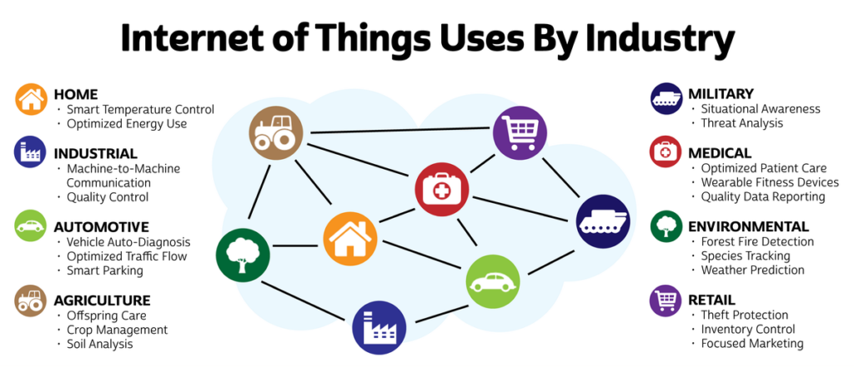
IoT Verticals

Slide 33
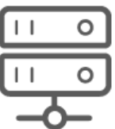
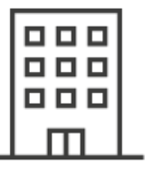
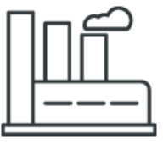

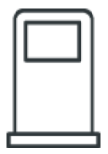
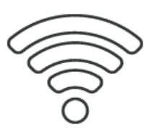
IoT Verticals
Smart Systems: Improve operational performance through seamless system integration.
Smart Buildings: Monitor and manage multiple eco-friendly properties in real-time.
Industrial IoT: Reduce human error, improve process accuracy, and reduce overall operational costs.
Transportation & Logistics: Enhance in-transit visibility while accelerating delivery time and operational efficiency.
Smart Oil & Gas: Eliminate on-site visits and increase regulatory compliance, reliability and efficiency.
Telecom: Develop new revenue streams and cross sell services while enhancing customer loyalty.

Slide 34
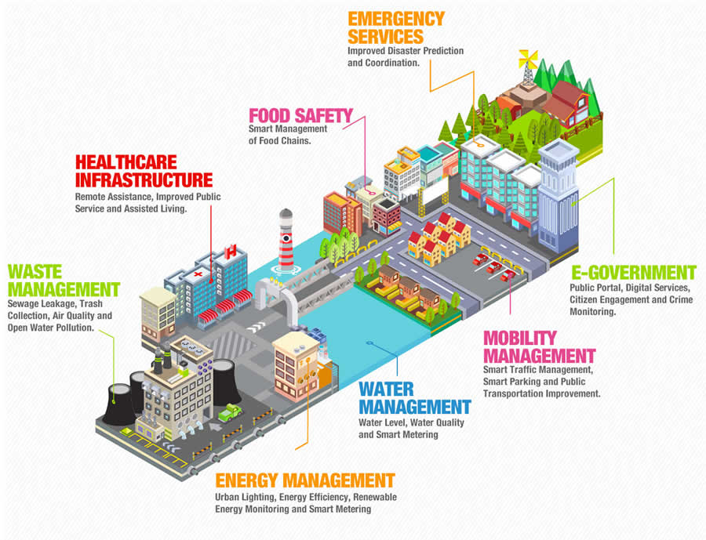
IoT Verticals

Slide 35
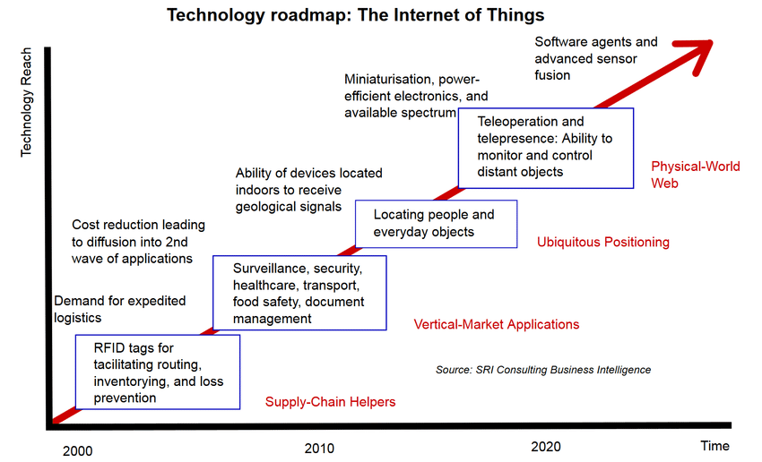
Roadmap for developing complete IoT solutions

Slide 36
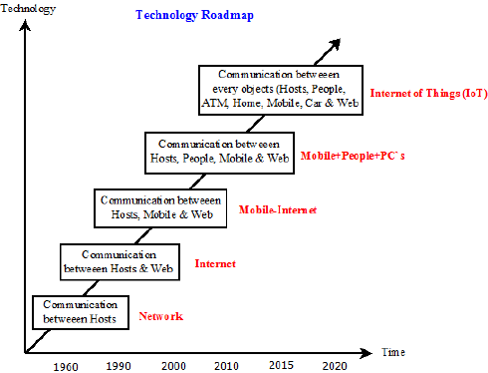
Roadmap for developing complete IoT solutions

Slide 37
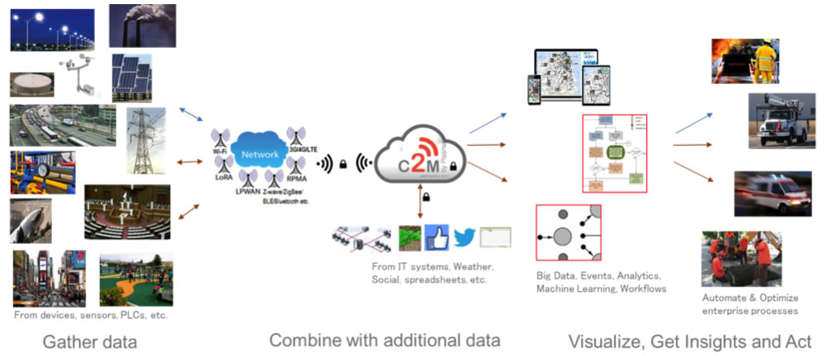
Smart City

Slide 38
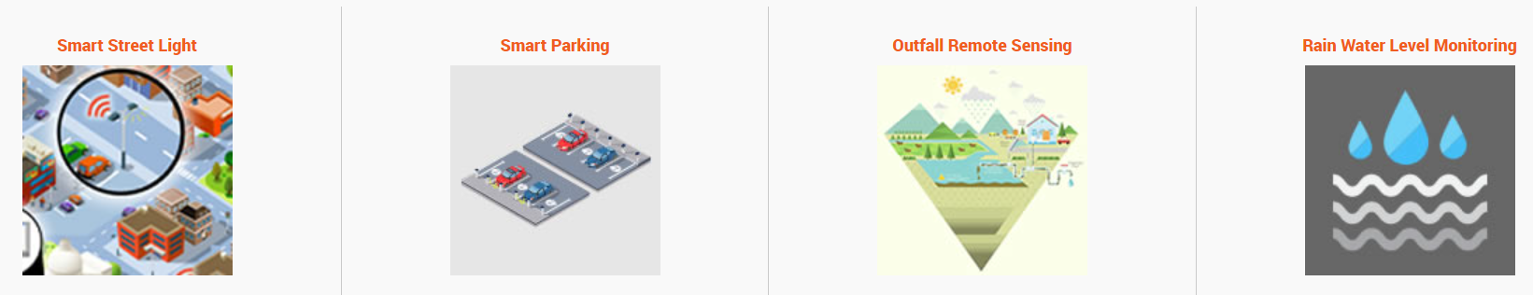
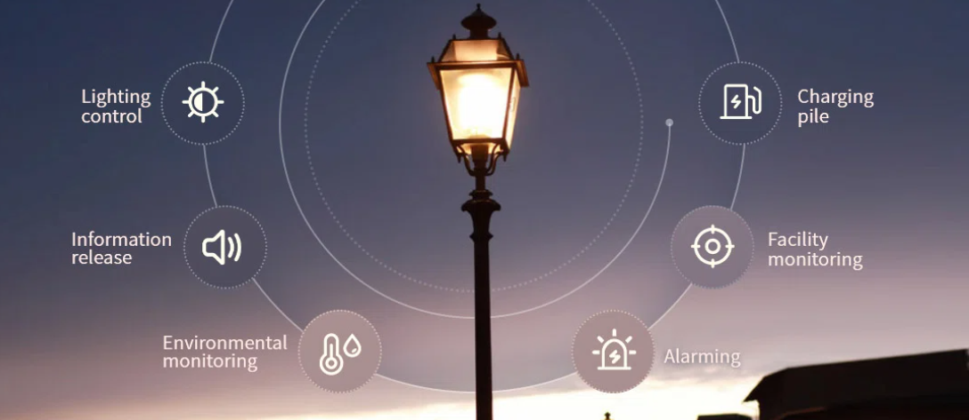
Smart City-Use Cases
A smart street light system incorporates a cluster of streetlight lamps that can communicate with each other and provide lighting data to a local concentrator. It allows facility managers to remotely control street lights while keeping track of electrical power consumption in the lamps and in the driving circuits.
Advantages:
With The Help Of IoT, Street Lights Can Switch ON And OFF Automatically.
Maintenance Of Street Lights Using IoT Is Quite Less Which Leads To Cost Reduction.
Street Lights Using IoT Will Also Reduce Light Pollution.
Power Consumption Is Quite Low In These Street Lights Using IoT Which Also Leads To Energy Conservation.
No Large Manpower Is Required To Maintain These Street Lights Using IoT.

Slide 39
Smart City-Use Cases
An IoT based smart parking system, also known as a connected parking system, is a centralized management system that allows drivers to use a smartphone app to search for and reserve a parking spot.
The system’s hardware features sensors that detect available parking slots and communicate this information to all drivers in the area. This data is updated in real-time, which means drivers never have to worry about not finding an available space.
In addition to helping drivers find a spot, the system also sends alerts about peak times and peak prices. The goal of these alerts is to help save drivers money while also reducing congestion.

Slide 40
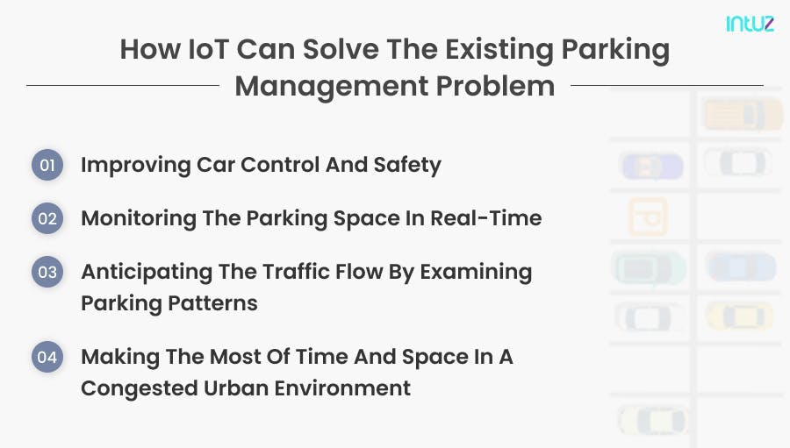
Smart City-Use Cases

Slide 41
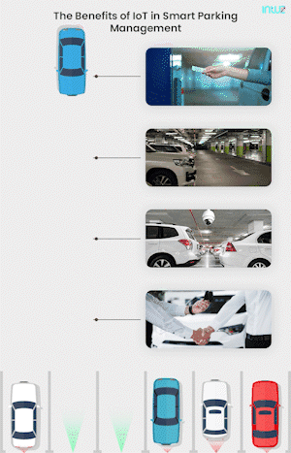
Smart City-Use Cases
Benefits
Reduced costs
Enhanced security
Increased efficiency
Improved customer experience

Slide 42
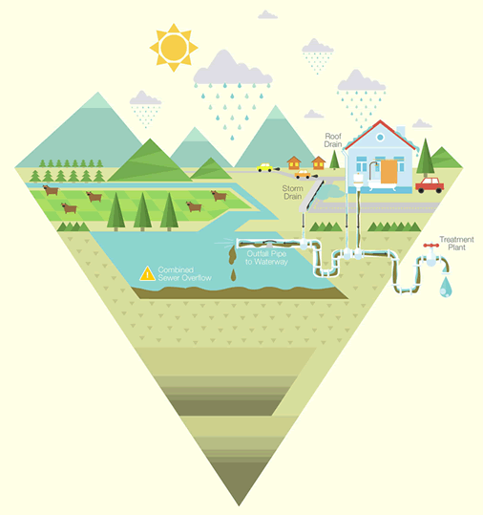
Smart City-Use Cases-Outfall Remote sensing
Hazardous waste from sewage pipelines cause a risk of contaminating beaches, lakes and underground water tables. This poses a major environmental and health risk. Monitoring sewage leakage is a critical challenge faced by every city.
To implement the monitoring of the sewage leaks, there is a need for a sensor grid with sensors for measuring level, water conductivity & accelerometer sensors.

Slide 43
Smart City-Use Cases
IoT-based water level monitoring provides automatic detection of liquid levels from differently sized tanks or storage containers.
It is a state-of-the-art system specially designed to inform the users about the real status of the liquid levels.
It is meticulously designed to benefit the industrialists with IoT technology and improve the overall business productivity.
IoT-based water level monitoring provides real-time autonomous detection of water levels and takes appropriate action based on the levels including overflowing, water depletion, and water usage.
Deploying an autonomous system to keep a real-time check upon the water levels provides an effective solution to water-related challenges.

Slide 44


Smart City-Use Cases

Slide 45

Smart City-Use Cases
Challenges

Slide 46

IoT in Agriculture and Farming
Smart agriculture, on the other hand, is mostly used to denote the application of IoT solutions in agriculture.
By using IoT sensors to collect environmental and machine metrics, farmers can make informed decisions, and improve just about every aspect of their work – from livestock to crop farming.
For example, by using smart agriculture sensors to monitor the state of crops, farmers can define exactly how many pesticides and fertilizers they have to use to reach optimal efficiency. The same applies to the smart farming definition.

Slide 47

IoT in Health care
Internet of Things (IoT)-enabled devices have made remote monitoring in the healthcare sector possible, unleashing the potential to keep patients safe and healthy, and empowering physicians to deliver superlative care.
It has also increased patient engagement and satisfaction as interactions with doctors have become easier and more efficient.
Furthermore, remote monitoring of patient’s health helps in reducing the length of hospital stay and prevents re-admissions.
IoT also has a major impact on reducing healthcare costs significantly and improving treatment outcomes.

Slide 48

IoT in Health care
IoT for Patients - Devices in the form of wearables like fitness bands and other wirelessly connected devices like blood pressure and heart rate monitoring cuffs, glucometer etc. give patients access to personalized attention.
These devices can be tuned to remind calorie count, exercise check, appointments, blood pressure variations and much more.
Enabling constant tracking of health conditions.
This has a major impact on people living alone and their families.
On any disturbance or changes in the routine activities of a person, alert mechanism sends signals to family members and concerned health providers.

Slide 49

IoT in Health care
IoT for Physicians - By using wearables and other home monitoring equipment embedded with IoT, physicians can keep track of patients’ health more effectively.
They can track patients’ adherence to treatment plans or any need for immediate medical attention.
IoT enables healthcare professionals to be more watchful and connect with the patients proactively.
Data collected from IoT devices can help physicians identify the best treatment process for patients and reach the expected outcomes.

Slide 50

IoT in Health care
IoT for Hospitals - Apart from monitoring patients’ health, there are many other areas where IoT devices are very useful in hospitals.
IoT devices tagged with sensors are used for tracking real time location of medical equipment like wheelchairs, defibrillators, nebulizers, oxygen pumps and other monitoring equipment.
Deployment of medical staff at different locations can also be analyzed real time.
The spread of infections is a major concern for patients in hospitals.
IoT-enabled hygiene monitoring devices help in preventing patients from getting infected.

Slide 51

IoT in Health care
IoT for Health Insurance Companies – There are numerous opportunities for health insurers with IoT-connected intelligent devices.
Insurance companies can leverage data captured through health monitoring devices for their underwriting and claims operations.
This data will enable them to detect fraud claims and identify prospects for underwriting.
IoT devices bring transparency between insurers and customers in the underwriting, pricing, claims handling, and risk assessment processes.

Slide 52

IoT in Health care
Redefining Healthcare–
Step 1: First step consists of deployment of interconnected devices that includes sensors, actuators, monitors, detectors, camera systems etc. These devices collect the data.
Step 2: Usually, data received from sensors and other devices are in analog form, which need to be aggregated and converted to the digital form for further data processing.
Step 3: Once the data is digitized and aggregated, this is pre-processed, standardized and moved to the data center or Cloud.
Step 4: Final data is managed and analyzed at the required level. Advanced Analytics, applied to this data, brings actionable business insights for effective decision-making.
IoT is redefining healthcare by ensuring better care, improved treatment outcomes and reduced costs for patients, and better processes and workflows, improved performance and patient experience for healthcare providers.

Slide 53
IoT in Health care
Advantages–
Cost Reduction: IoT enables patient monitoring in real time, thus significantly cutting down unnecessary visits to doctors, hospital stays and re-admissions
Improved Treatment: It enables physicians to make evidence-based informed decisions and brings absolute transparency
Faster Disease Diagnosis: Continuous patient monitoring and real time data helps in diagnosing diseases at an early stage or even before the disease develops based on symptoms
Proactive Treatment: Continuous health monitoring opens the doors for providing proactive medical treatment
Drugs and Equipment Management: Management of drugs and medical equipment is a major challenge in a healthcare industry. Through connected devices, these are managed and utilized efficiently with reduced costs
Error Reduction: Data generated through IoT devices not only help in effective decision making but also ensure smooth healthcare operations with reduced errors, waste and system costs

Slide 54

Challenges in Modern Agricultural Industry
Lack of workforce and manpower
Environmental challenges and global warming
Requirement of large manual intervention
Lack of proper monitoring
Challenges in analyzing the large scale unstructured data

Slide 55

Benefits of smart farming

Slide 56

Smart farming Features
Data, tons of data, collected by smart agriculture sensors, e.g. weather conditions, soil quality, crop’s growth progress or cattle’s health. This data can be used to track the state of your business in general as well as staff performance, equipment efficiency, etc.
Better control over the internal processes and, as a result, lower production risks. The ability to foresee the output of your production allows you to plan for better product distribution. If you know exactly how much crops you are going to harvest, you can make sure your product won’t lie around unsold.
Cost management and waste reduction for the increased control over the production. Being able to see any anomalies in the crop growth or livestock health, you will be able to mitigate the risks of losing your yield.

Slide 57

Smart farming Features
Increased business efficiency through process automation. By using smart devices, you can automate multiple processes across your production cycle, e.g. irrigation, fertilizing, or pest control.
Enhanced product quality and volumes. Achieve better control over the production process and maintain higher standards of crop quality and growth capacity through automation.
Reduced environmental footprint. Automation also carries environmental benefits. Smart farming technologies can cut down on the use of pesticides and fertilizer by offering more precise coverage, and thus, reduce greenhouse gas emissions.

Slide 58
IoT use cases in agriculture
Monitoring of climate conditions
The most popular smart agriculture gadgets are weather stations, combining various smart farming sensors. Located across the field, they collect various data from the environment and send it to the cloud. The provided measurements can be used to map the climate conditions, choose the appropriate crops, and take the required measures to improve their capacity (i.e. precision farming).
Some examples of such agriculture IoT devices are all METEO, Smart Elements, and Pycno.

Slide 59

IoT use cases in agriculture
Greenhouse automation
Typically, farmers use manual intervention to control the greenhouse environment. The use of IoT sensors enables them to get accurate real-time information on greenhouse conditions such as lighting, temperature, soil condition, and humidity.
In addition to sourcing environmental data, weather stations can automatically adjust the conditions to match the given parameters.
Specifically, greenhouse automation systems use a similar principle.
For instance, Farmapp and Growlink are also IoT agriculture products offering such capabilities among others.

Slide 60

IoT use cases in agriculture
Crop management
One more type of IoT product in agriculture and another element of precision farming are crop management devices.
Just like weather stations, they should be placed in the field to collect data specific to crop farming; from temperature and precipitation to leaf water potential and overall crop health.
Thus, you can monitor your crop growth and any anomalies to effectively prevent any diseases or infestations that can harm your yield.
Arable and Semios can serve as good representations of how this use case can be applied in real life.

Slide 61
IoT use cases in agriculture
Cattle monitoring and management
Just like crop monitoring, there are IoT agriculture sensors that can be attached to the animals on a farm to monitor their health and log performance. Livestock tracking and monitoring help collect data on stock health, well-being, and physical location.
For example, such sensors can identify sick animals so that farmers can separate them from the herd and avoid contamination. Using drones for real-time cattle tracking also helps farmers reduce staffing expenses. This works similarly to IoT devices for petcare.
For example, SCR by Allflex and Cowlar use smart agriculture sensors (collar tags) to deliver temperature, health, activity, and nutrition insights on each individual cow as well as collective information about the herd.

Slide 62
IoT use cases in agriculture
Precision farming
Also known as precision agriculture, precision farming is all about efficiency and making accurate data-driven decisions.
By using IoT sensors, farmers can collect a vast array of metrics on every facet of the field microclimate and ecosystem: lighting, temperature, soil condition, humidity, CO2 levels, and pest infections.
This data enables farmers to estimate optimal amounts of water, fertilizers, and pesticides that their crops need, reduce expenses, and raise better and healthier crops.
For example, CropX builds IoT soil sensors that measure soil moisture, temperature, and electric conductivity enabling farmers to approach each crop’s unique needs individually. Combined with geospatial data, this technology helps create precise soil maps for each field. Mothive offers similar services, helping farmers reduce waste, improve yields, and increase farm sustainability.

Slide 63

IoT use cases in agriculture
Agricultural drones
Perhaps one of the most promising agritech advancements is the use of agricultural drones in smart farming.
Also known as UAVs (unmanned aerial vehicles), drones are better equipped than airplanes and satellites to collect agricultural data.
The data collected from these drones are sent back to the server to be used for analysis and decision-making.
Apart from surveillance capabilities, drones can also perform a vast number of tasks that previously required human labor: planting crops, fighting pests and infections, agriculture spraying, crop monitoring, etc.
DroneSeed, for example, builds drones for planting trees in deforested areas.

Slide 64
IoT use cases in agriculture
Predictive analytics for smart farming
Precision agriculture and predictive data analytics go hand in hand. While IoT and smart sensor technology are a goldmine for highly relevant real-time data, the use of data analytics helps farmers make sense of it and come up with important predictions: crop harvesting time, the risks of diseases and infestations, yield volume, etc.
Data analytics tools help make farming, which is inherently highly dependent on weather conditions, more manageable, and predictable.
For example, the Crop Performance platform helps farmers access the volume and quality of yields in advance, as well as their vulnerability to unfavorable weather conditions, such as floods and drought. It also enables farmers to optimize the supply of water and nutrients for each crop and even select yield traits to improve quality.

Slide 65
IoT use cases in agriculture
End-to-end farm management systems
A more complex approach to IoT products in agriculture can be represented by the so-called farm productivity management systems. They usually include a number of agriculture IoT devices and sensors, installed on the premises as well as a powerful dashboard with analytical capabilities and in-built accounting/reporting features.
This offers remote farm monitoring capabilities and allows you to streamline most of the business operations. Similar solutions are represented by FarmLogs and Cropio.
In addition to the listed IoT agriculture use cases, some prominent opportunities include vehicle tracking (or even automation), storage management, logistics, etc.

Slide 66

IoT use cases in agriculture
Predictive analytics for smart farming

Slide 67
IoT use cases in agriculture
Robots and autonomous machines
Robotic innovations also offer a promising future in the field of autonomous machines for agricultural purposes.
Some farmers already use automated harvesters, tractors, and other machines and vehicles that can operate without a human controlling it. Such robots can complete repetitive, challenging, and labor-intensive tasks.
For instance, modern agrobots include automated tractors that can work on assigned routes, send notifications, start work at planned hours, etc. Such tractors are driverless and cut farmers’ labor costs. Bear Flag Robotics is one company that works on such technology at the moment.

Slide 68

IoT use cases in agriculture

Slide 69
IoT use cases in agriculture
Challenges to Building the Internet of Things Platform
A unified solution that can be integrated with different types of Internet of Things devices.
The most common challenge for the Internet of Things in agriculture is connectivity. Every area doesn’t have proper internet connectivity.
The second most common challenge for the Internet of Things based Advanced Agriculture is the lack of awareness among consumers.
Due to various service providers, it becomes really difficult to maintain interoperability between different IoT systems.
A scalable solution that can be integrated with thousands of IoT devices for large farms.

Slide 70
IoT use cases in agriculture
Solutions for Building IoT based Intelligent Agriculture
Smart Farming has enabled farmers to reduce waste and enhance productivity with the help of sensors (light, humidity, temperature, soil moisture, etc.) and automation of irrigation systems.
Further, with the help of these sensors, farmers can monitor the field conditions from anywhere.
Internet of Things-based Advanced Farming is highly efficient when compared with the conventional approach.
The applications of intelligent Agriculture solutions not only target conventional, large farming.

Slide 71
IoT use cases in agriculture
Solutions for Building IoT based Intelligent Agriculture
With operations, but could also be new levers to uplift other growing or common trends in agriculture like organic farming, family farming (complex or small spaces, particular cattle and/or cultures, preservation of specific or high-quality varieties, etc.), and enhance highly transparent Farming.
In Azure, IoT Hub acts as the central unit which allows connecting, monitoring and managing millions of devices using bi-directional messaging. It supports AMQP, MQTT, and HTTP protocols for communication with IoT devices.
It also helps their own protocol gateway Azure IoT Protocol Gateway, in case a device doesn’t support AMQP, MQTT, or HTTP.

